Slide 1
Music Rater – Status for 10/7/2024
Adrianna Bordonaro, Project Manager
adrianna.bordonaro1@marist.edu

Slide 2
Executive Summary
Complete: Basic home page and account info page, Spotify login
On schedule: Profile picture upload (AWS S3), UX/UI design
In progress: N/A
At risk: N/A
Complete: Email & password accounts, Google login, changing username

Slide 3
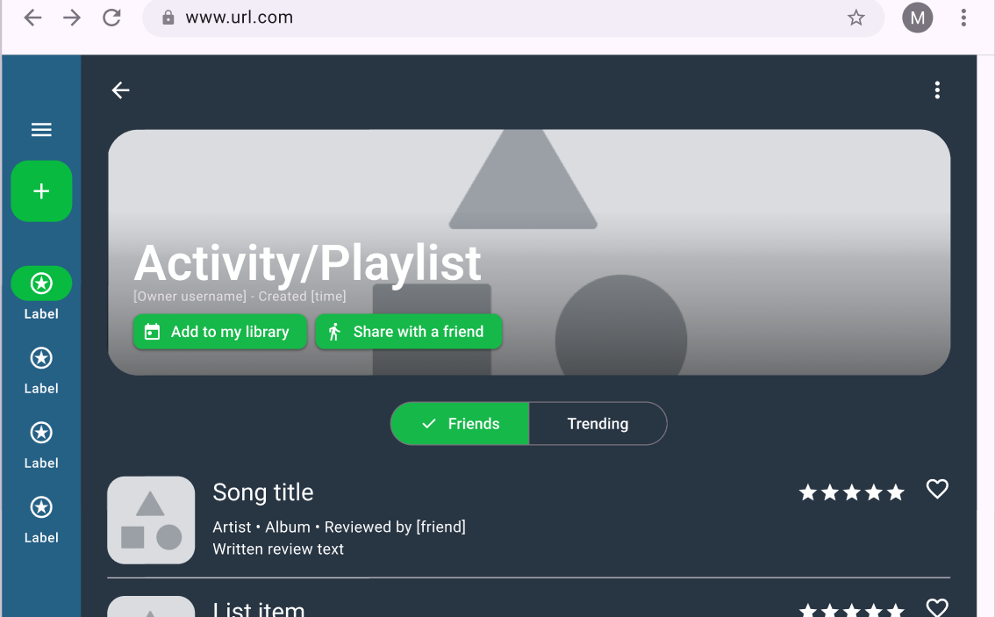
Status Details
Spotify login
Localhost prevents full functionality - we have a workaround
UX/UI
Details (rating, song view)

Slide 4
Next Steps / Actions
Finalize UX/UI design details
Move forward with Spotify API integration
Fix issues (profile photo, Spotify login)

Slide 5
Thank you
Questions?

